Slide 1
Problem Statement -1
Python, Data Analytics

Slide 2
You are the Data Analyst working with the Customer Strategies department of a global broadband internet service provider. Of late, you have received heads up from the management about the Customers churning out of the service due to multiple reasons. As part of the requirement of the management you need to classify the customers into different segments so that specific business actions can be initiated. For example, from the list of customers if you could segment the customers who are happy with our service, customers who are NOT so happy with our service, customers to whom a higher revenue plan can be sold off etc., the team can initiate targeted efforts to each of the segment of customers differently so that we stop the churning customers, retain the existing happy customer and sell a higher revenue plan to customer who probably might buy it and many other segments that would make a valid business sense.
A sample of 200 customers with variables namely Usage, Cost and No of Issues faced (Refer excel sheet) available.

Slide 3
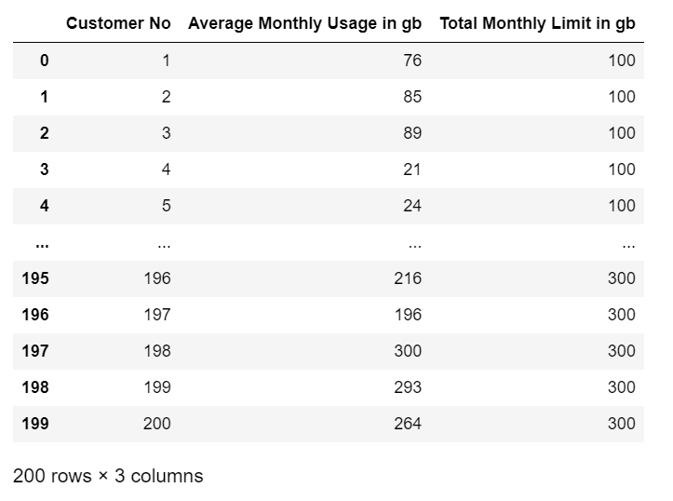
Usage

Slide 4
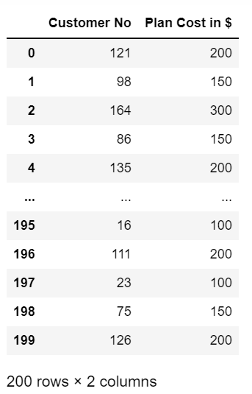
Cost

Slide 5
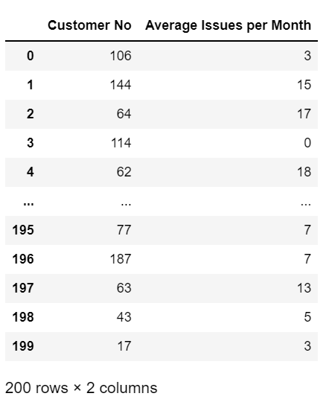
Issues

Slide 6
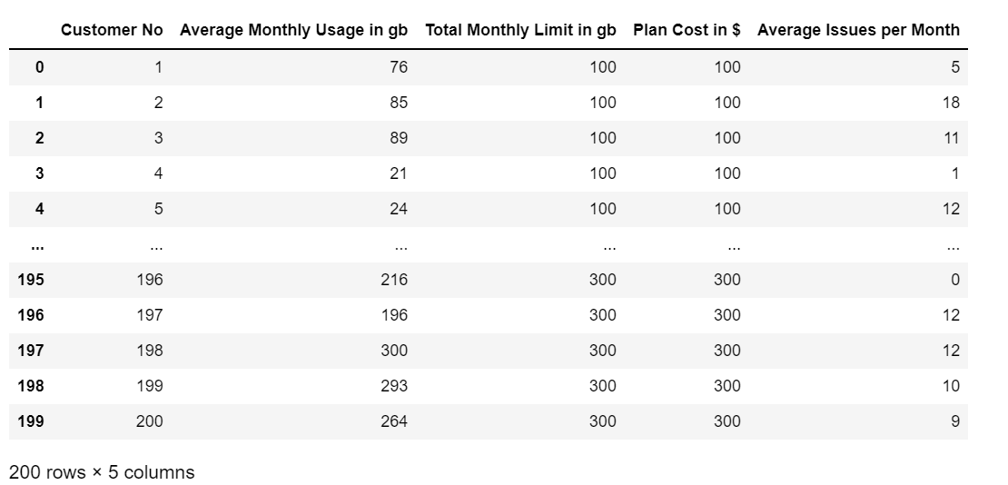
Combining all Dataframes based on Customer No

Slide 7
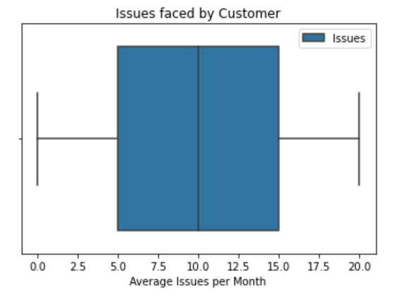
Segmenting happy and unhappy customers
No of issue less than or equal to 25th percentile, he/she is considered a happy customer else not. This is chosen based on box plot.

Slide 8
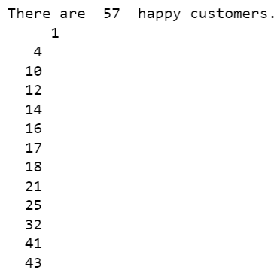
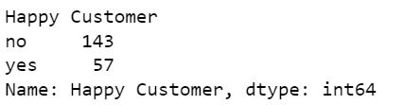
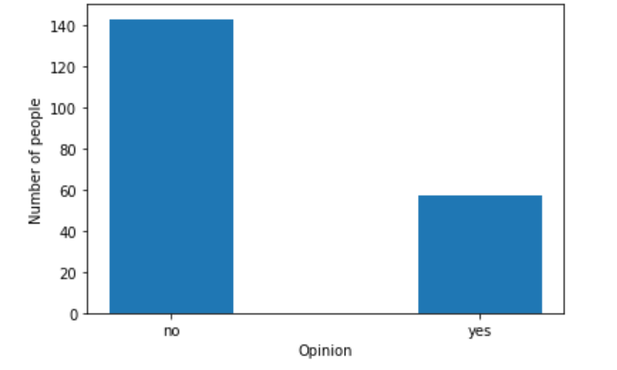
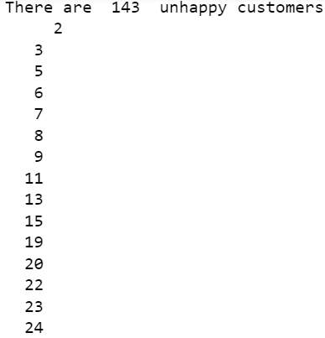
Segmenting happy and unhappy customers

Slide 9
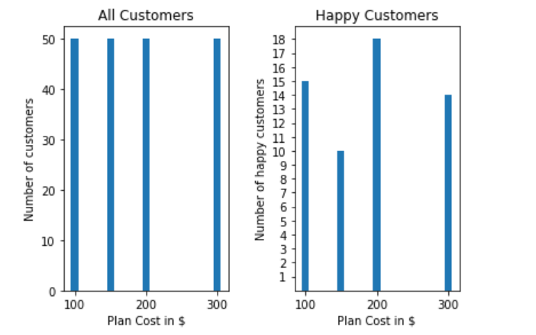
Recommend Higher Revenue Plans
Plans are recommended to only happy customers(less issues) who have not the highest data plan chosen, also with customers who use more than half of the total data available

Slide 10
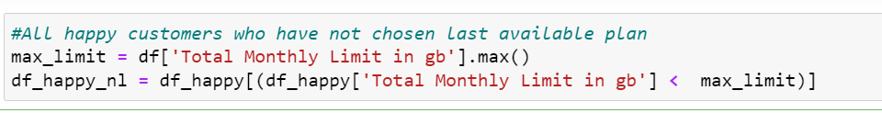
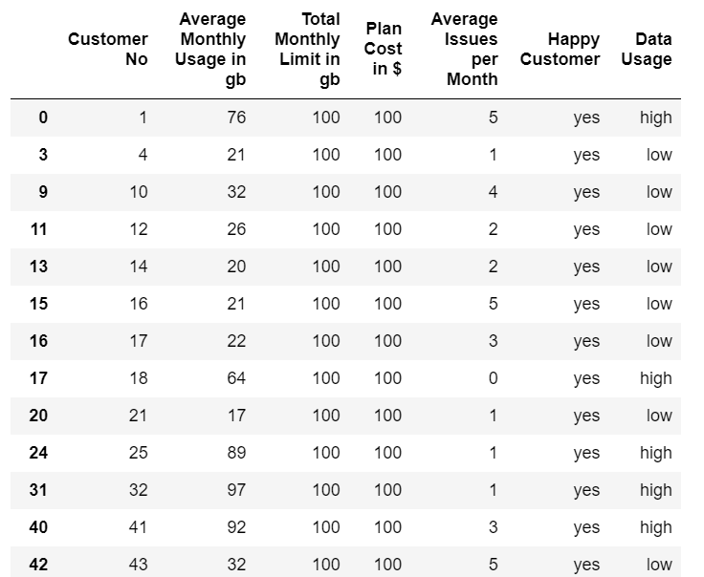
Recommend Higher Revenue Plans
Data Usage of unhappy customers(exclude last plan)

Slide 11
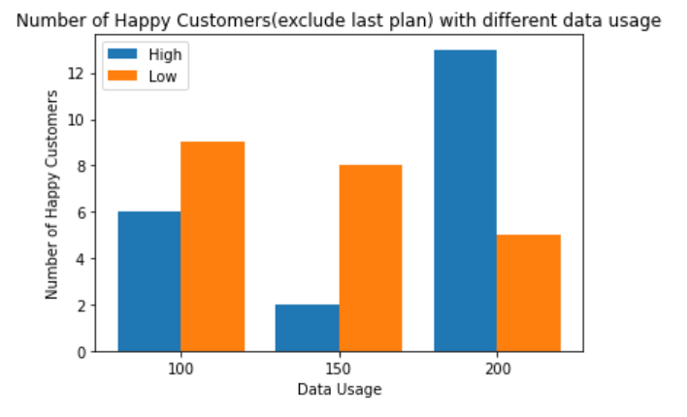
Recommend Higher Revenue Plans
Number of Happy Customers (exclude last plan) with different data usage

Slide 12
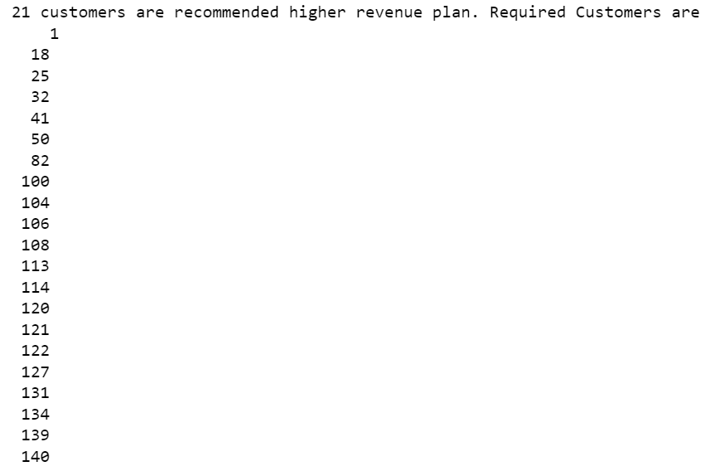
Recommend Higher Revenue Plans
Ans

Slide 13
Discount Possibilities for Unhappy customers
For all the unhappy customers, checking out if discounts can be provided.
This is applicable only if an unhappy customer uses less than three fourth of the total amount.
Process - There are two criteria:
Finding a plan that is just lower than the amount used and charge for extra data using a multiplier ($x per gb)
Finding a plan just higher than the amount used.
Compare both the costs(1 and 2) and choose the one with the lowest cost for every customer

Slide 14
Discount Possibilities for Unhappy customers
Finding out a suitable multiplier
1.25 is chosen if amount of data used is less than median of plans available or has used less than half of the amount for the plans higher than median , else mul =1.5
E.g. Median = 175, so with plans 0gb, 100gb, 150gb, mul = 1.25 and for 200gb, mul both 1.25 and 1.5
After recommending a correct plan, the amount that can be discounted to users are also printed which may be given as coupon to unhappy customers next month

Slide 15
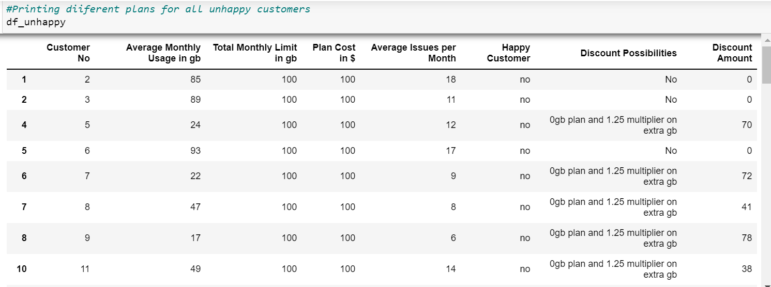
Discount Possibilities for Unhappy customers

Slide 16
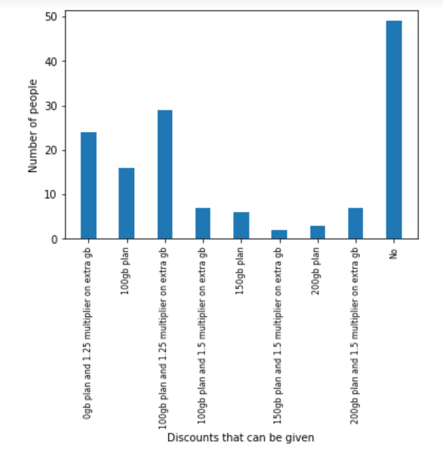
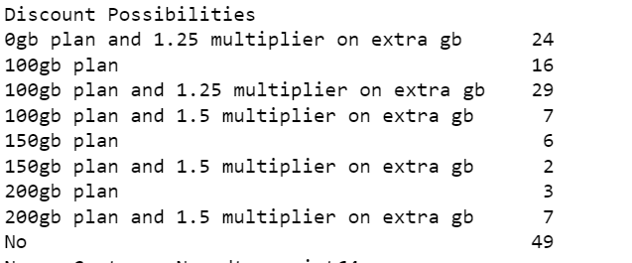
Discount Possibilities for Unhappy customers
Grouping customers based on different offers provided

Slide 17
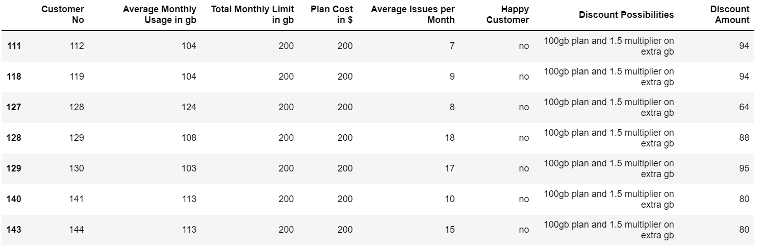
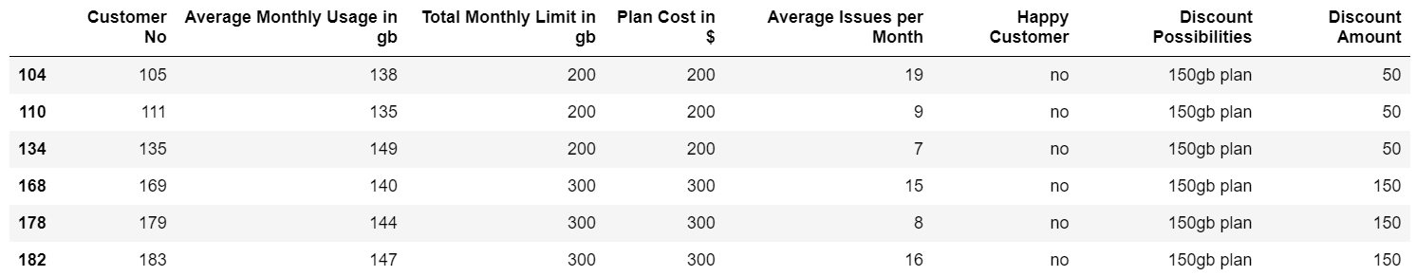
Discount Possibilities for Unhappy customers
Customers - 100gb plan and 1.5 multiplier on extra gb
Customers - 150gb plan

Slide 18
Check if there are any other issues other than cost
Issues regarding continuous Data Provision
Comparing Customers with high issues and high data usage with total number of unhappy customers
If value is high(say greater than 0.5, even that's considered an actual reason with the available parameters)

Slide 19
THANK YOU

